Slide 1
Overview Week 04
Andrew Beatty
Andrew.Beatty@gmit.ie
Programming and Scripting
P 4.0

Slide 2
This Week
Controlling the flow
If statements (elif and else)
While loops
For loops
Data camp invite

Slide 3
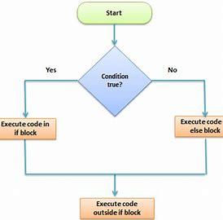
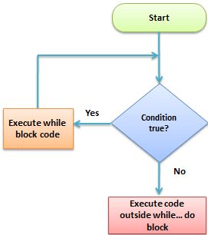

normal
If else
While loop
Or
For Loop
start
Statement 1
Statement 2
Statement 3

